Slide 1
Catering Robot
Course Project: BITS F327 Artificial Intelligence for Robotics

Slide 2
Acknowledgements
We would like to thank Dr. Abhishek Sarkar for his valuable guidance and support.
Special thanks to Mr. Suryanarayana for his support and assistance.
Finally, we would like to thank our university, BITS Pilani, for the opportunities it provides us.

Slide 3
Introduction
As human living standards keep on improving continuously, robots gradually entered our daily lives to make things easier and interesting. Out of these service robots, catering robots are one of the most interesting and useful robots.
Catering service robots working in restaurants are usually integrated with multi sensor data fusions, autonomous mobile and multimodal human computer interaction techniques.
They can partially or completely take the role of restaurant staff as they can be used by customers for ordering food and provide delivering services in the restaurant along with friendly interactions and self mobility.
Hence they are very beneficial, as they come with good marketing effectiveness and potential profitable advantages.
Commercial waiter robots can go up to $10,000. For example, BellaBot.

Slide 4
Objectives
In this project, we aimed to tackle 3 main aspects when it comes to approaching a real life Catering Robot:
Path Planning: Implementing D* Lite Algorithm which allows for course correction.
Simulation: using box2d, which is a 2-dimensional physics engine, and matplotlib to simulate motion in a restaurant-like environment.
SLAM: using the publicly available FastSLAM algorithms to attempt tackling the simultaneous localization and mapping (SLAM) problem.

Slide 5
Theory and Algorithms used
We use a pre-built robot kit with the necessary tools and functions as well as the simulation environment tools by Brian Blais from Bryant University (https://github.com/bblais) for our project.
It allows the user to build basic 2D robots of various shapes. The robot has a list of functions that allows us to build various new functions for motion and path planning.
It involves a simulation environment built with box2d and visualization with matplotlib.
pybox2d is a 2D physics library for your games and simple simulations. It's based on the Box2D library, written in C++. It supports several shape types (circle, polygon, thin line segments), and quite a few joint types (revolute, prismatic, wheel, etc.).
Matplotlib is a comprehensive plotting library for creating static, animated, and interactive visualizations in Python.

Slide 6
Theory and Algorithms used (Cont’d…)
We then implement path planning using D* Lite algorithm. It is useful for our use case as it is a simpler version of D* while also allow for course correction by replanning the path as obstacles are encountered.
D* Lite is an incremental heuristic search that repeatedly determines shortest paths between the current node of the robot and the goal node as the edge costs of a graph change while the robot moves towards the goal node. It is based upon the idea as A*. It adapts to obstacles with minimum cost to reach the goal.
Autonomous robots are the ones that act without recourse to human control and show some degree of self sufficiency.
The first autonomous robot environment known as Elmer and Elsie were first constructed in the late 1940s by Grey Walter.

Slide 7
Theory and Algorithms used (Cont’d…)
The Finite State Machine is an abstract mathematical model of a sequential logic function and can be implemented in real life circuits with the help of Flip Flops. It has finite inputs, outputs and number of states. It can change from one state to another as response to some inputs.
The robotic controller acts as the brain of a robot as it usually interrupts coding that serves as the program for a given robotic application. It deciphers the code into instructions for the articulated robot to use in order to operate and carry out the steps of application.
The SLAM problem involves a moving vehicle attempting to recover a spatial map of its environment, while simultaneously estimating its own pose (location and orientation) relative to the map. SLAM problems arises in the navigation of mobile robots through unknown environments for which no accurate map is available.

Slide 8
Theory and Algorithms used (Cont’d…)
Kalman filtering, also known as linear quadratic estimation (LQE), is an algorithm that uses a series of measurements observed over time, including statistical noise and other inaccuracies, and produces estimates of unknown variables that tend to be more accurate than those based on a single measurement alone, by estimating a joint probability distribution over the variables for each timeframe.
In estimation theory, the Extended Kalman Filter (EKF) is the nonlinear version of the Kalman filter which linearizes about an estimate of the current mean and covariance. In the case of well defined transition models, the EKF has been considered the de facto standard in the theory of nonlinear state estimation, navigation systems and GPS. Normal KF is discrete while EKF works with continuous time and change.

Slide 9
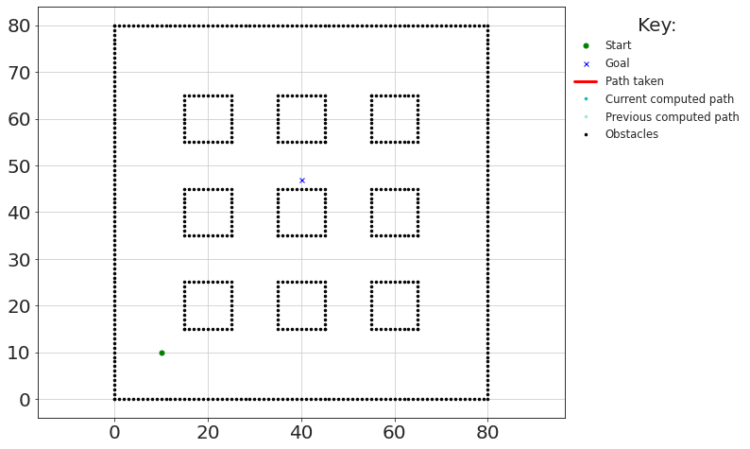
Simulation Details [D* Lite]
In this environment, 9 tables are used as shown: each having 10*10 unit^2 area
Overall square boundary :80*80 unit^2
Cost of motion from one node to next (i.e one point to another) is either 1 or sqrt(2).
Coordinates can only be integers.

Slide 10
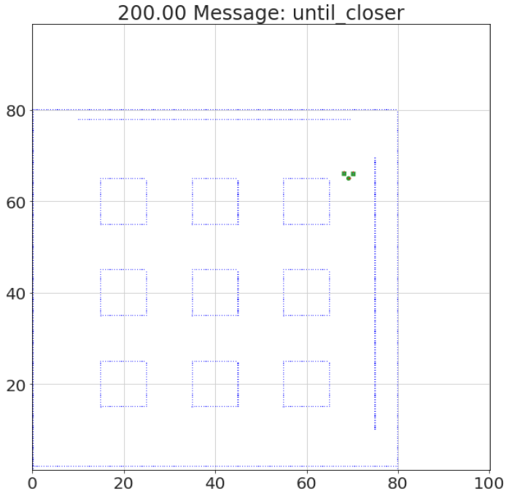
Simulation Details [box2d]
The environment is build with box2d and matplotlib. It’s dimensions are 100*100 unit^2
Robot dimensions:
Both boxes => 1*1 unit^2
Disk => pi*(0.5)^2 unit^2
Table dimensions:
10*10 unit^2
Obstacle dimensions:
60*0.2 unit^2
Currently, the obstacles are static.
Run time is 200; detail display is 5.

Slide 11
FastSLAM: Details and Implementation
FastSLAM is a SLAM algorithm that integrates particle filters and extended Kalman filters, introduced in a paper by Thrun et al. (2004). Particle filtering uses a set of particles to represent the posterior distribution of a stochastic process given the noisy and/or partial observations.
It exploits a structural property of the SLAM problem; feature estimates are conditional independent given the robot path. More specifically, correlations in the uncertainty among different map features arise only through robot pose uncertainty.
If the robot was told its correct path, the errors in its feature estimates would be independent of each other. This observation allows us to define a factored representation of the posterior over poses and maps.

Slide 12
FastSLAM: Details and Implementation (cont’d…)
In this project, we have implemented FastSLAM 1.0, which was the earliest version of the FastSLAM family of algorithms, and it was also the easiest to implement.
The key advantage of FastSLAM , however, is the fact that data association decisions can be made on a per-particle basis, similar to multi-hypothesis tracking algorithms.
Another advantage of FastSLAM is that particle filters can cope with non-linear robot motion models, whereas say an EKF-style approach approximate such models via linear functions.

Slide 13
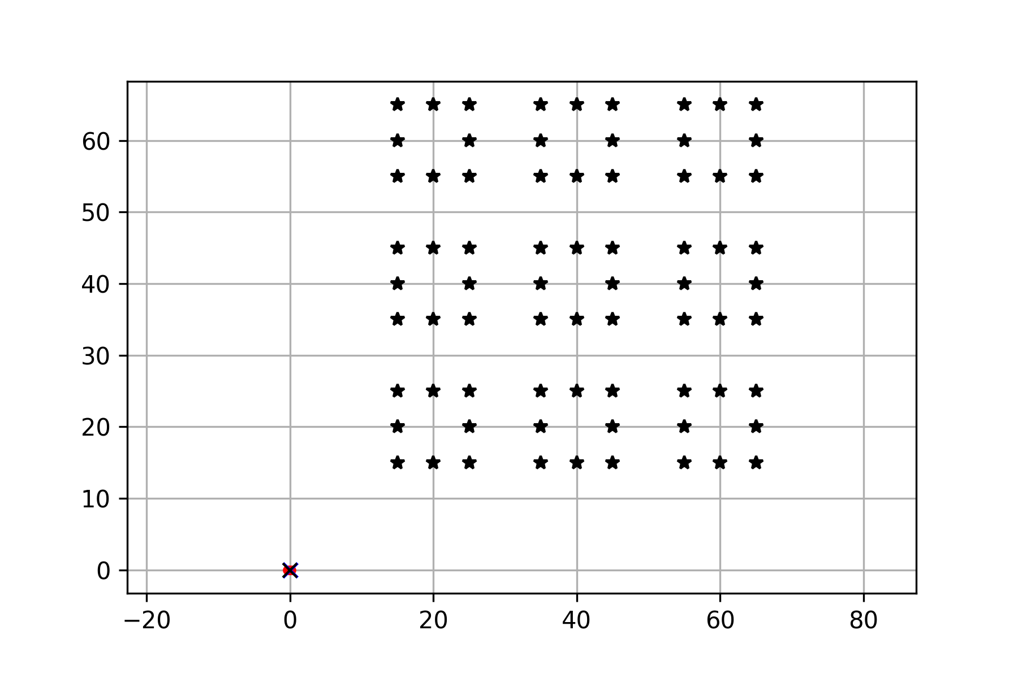
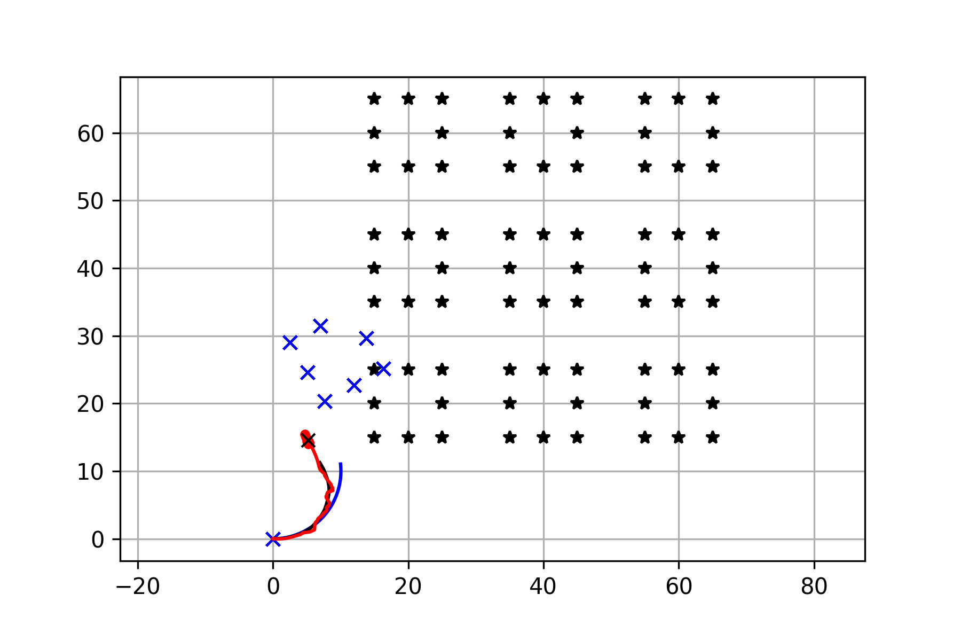
Simulation Details [FastSLAM]
The environment is based on a project done by Atsushi Sakai (UC Berkeley).
The blue line is ground truth, the black line is dead reckoning, the red line is the estimated trajectory with FastSLAM.
The red points are particles of FastSLAM.
Black points are landmarks, blue crosses are estimated landmark positions by FastSLAM.

Slide 14

D* Lite: Results
There are 9 tables and 4 seats each; 36 possible goal nodes and they are randomly selected.
After initial path is computed, two random obstacles are introduced after some initial movement; one along x axis and one along y axis.
Obstacles are randomly introduces from a set of 6 possible obstacles we have defined.
The path is then recomputed.
Final path is obtained.

Slide 15
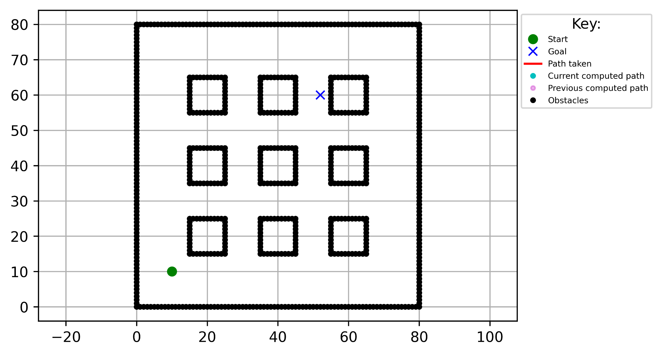
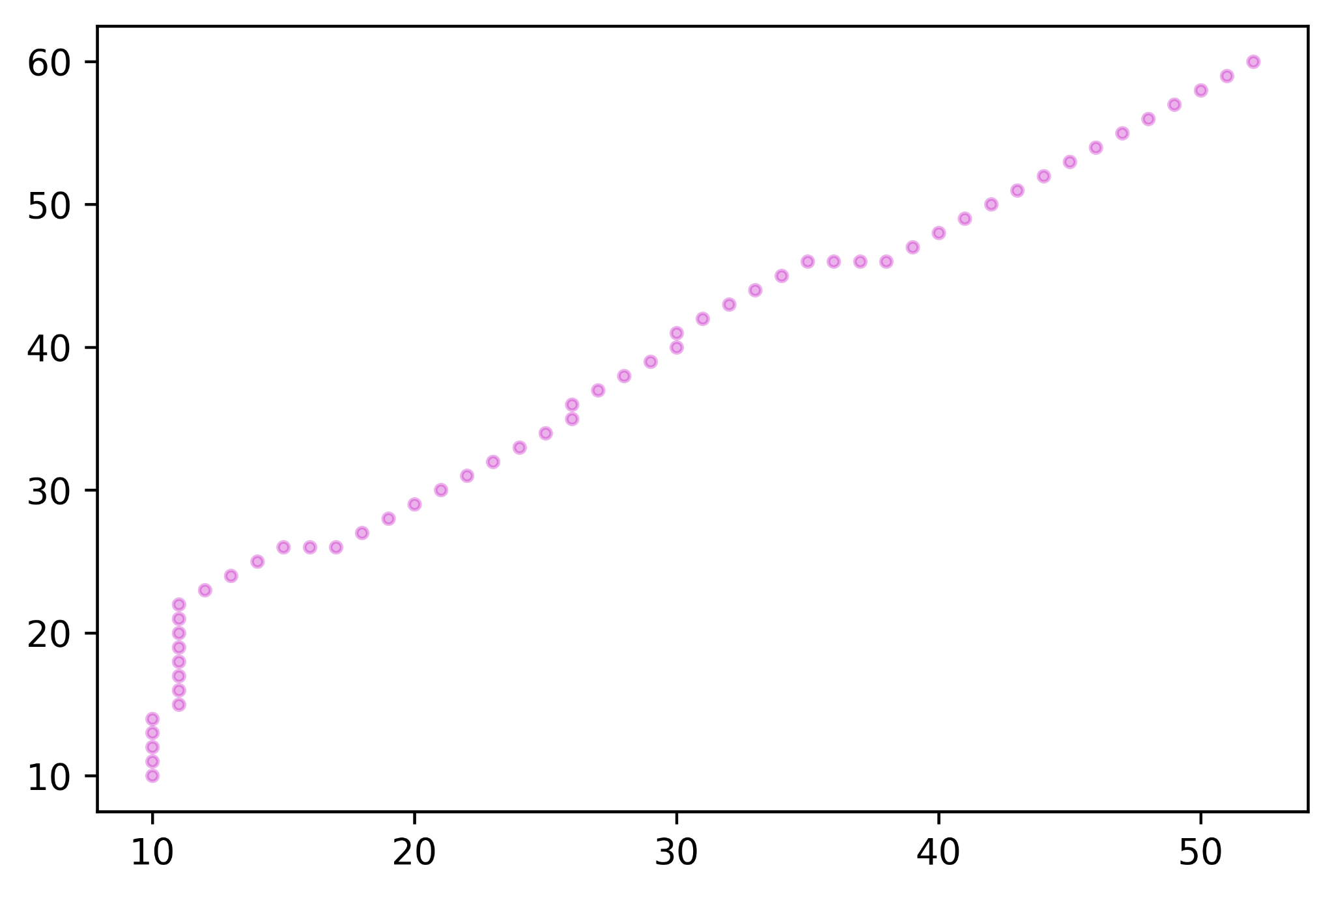
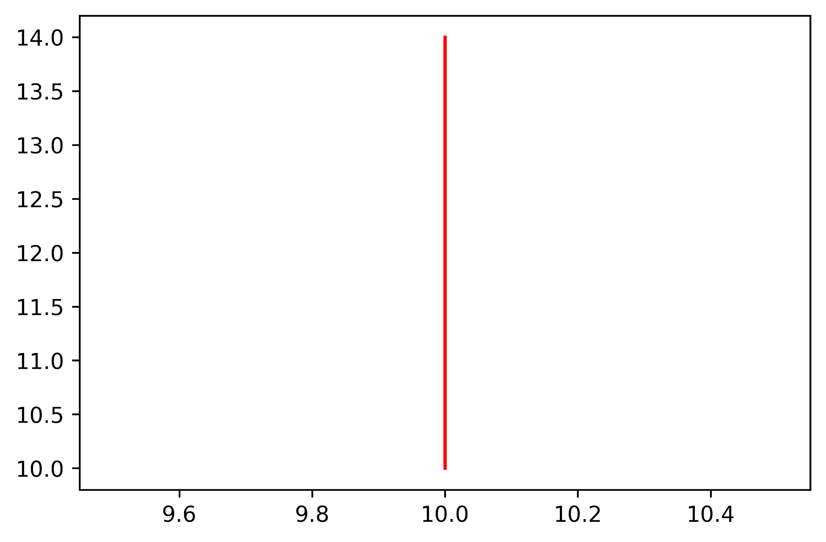
D* Lite: Results (Cont’d…)
Iteration 0:
The path is then computed.
The environment, with start and goal nodes, is set.
The robot starts to move along computed path

Slide 16
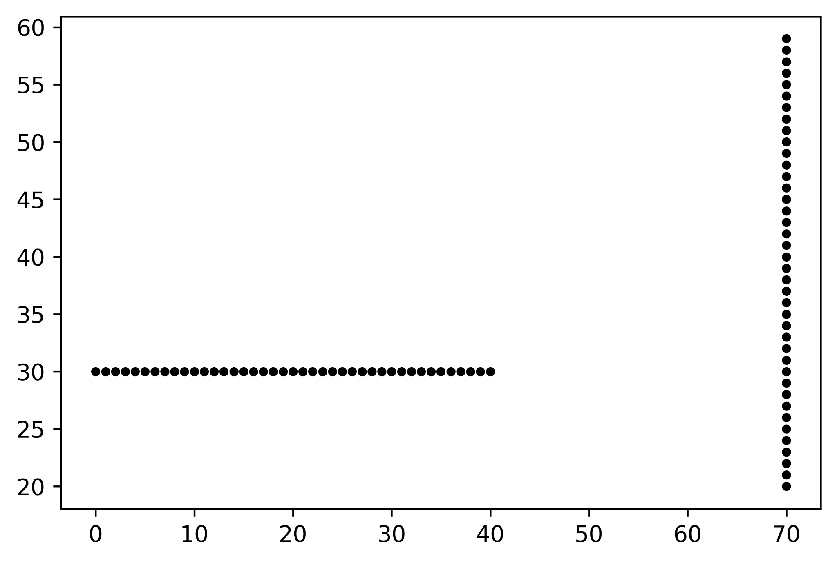
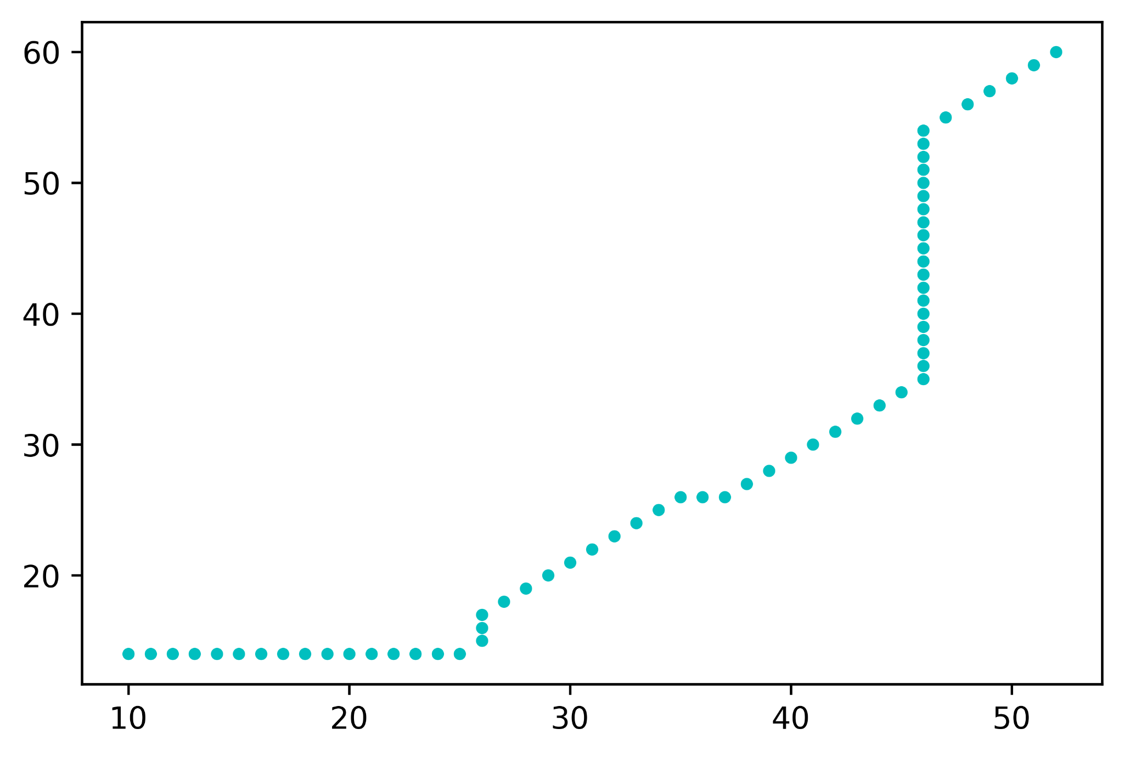
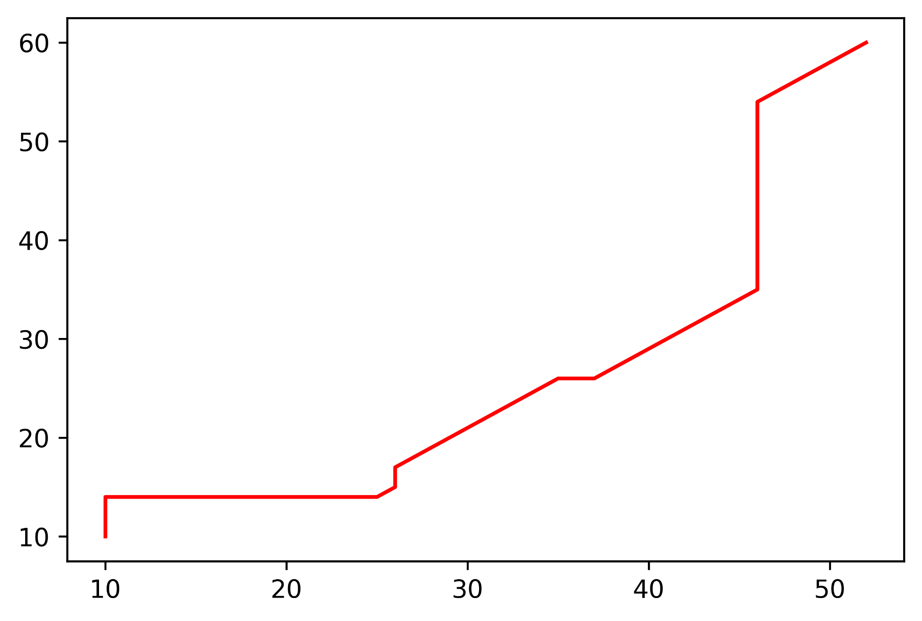
D* Lite: Results (Cont’d…)
The path is then course corrected taking obstacles into account
Obstacles are randomly introduced into the environment
The robot moves along the newly computed path and reaches goal node.

Slide 17
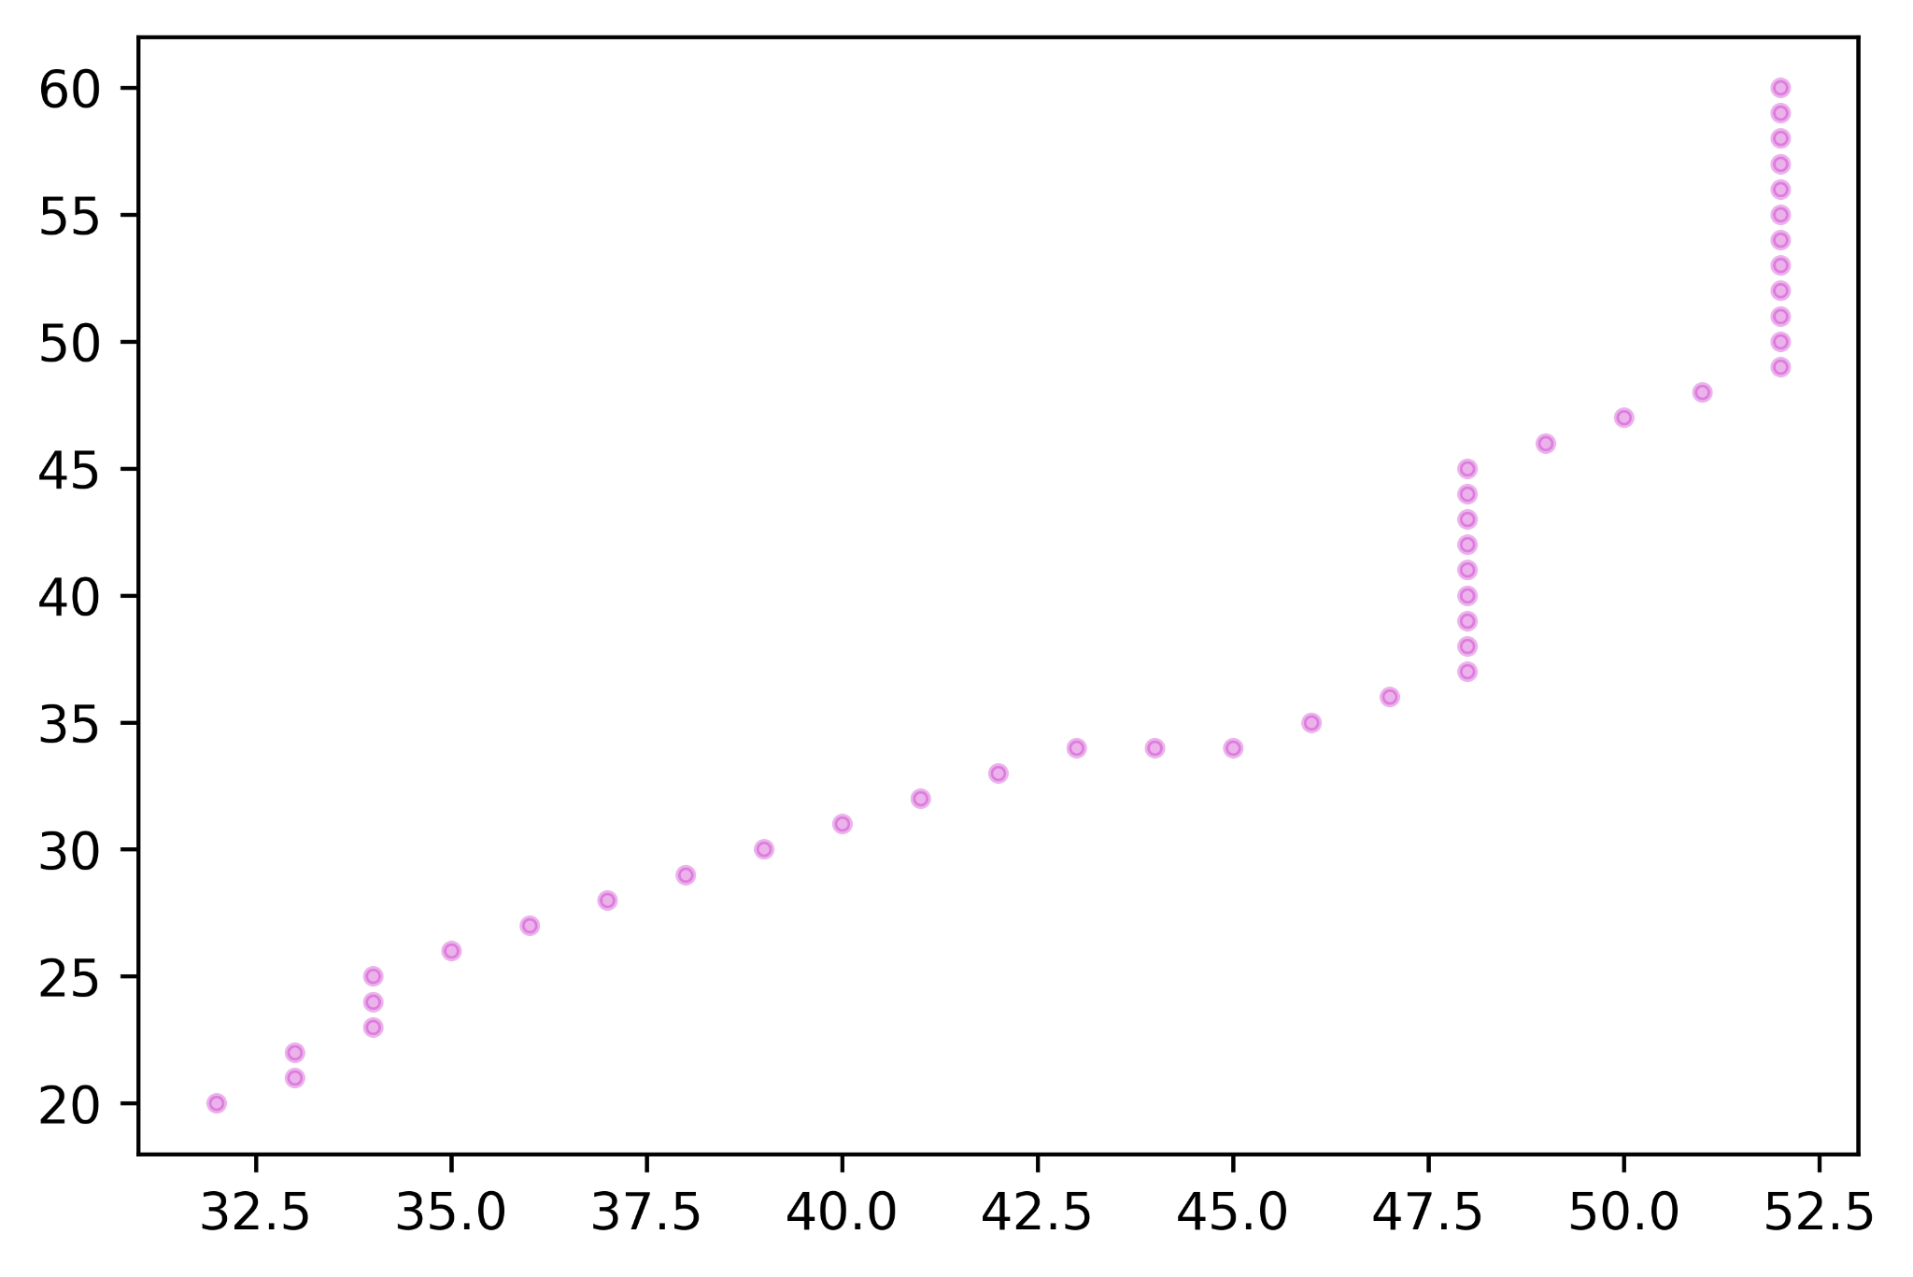
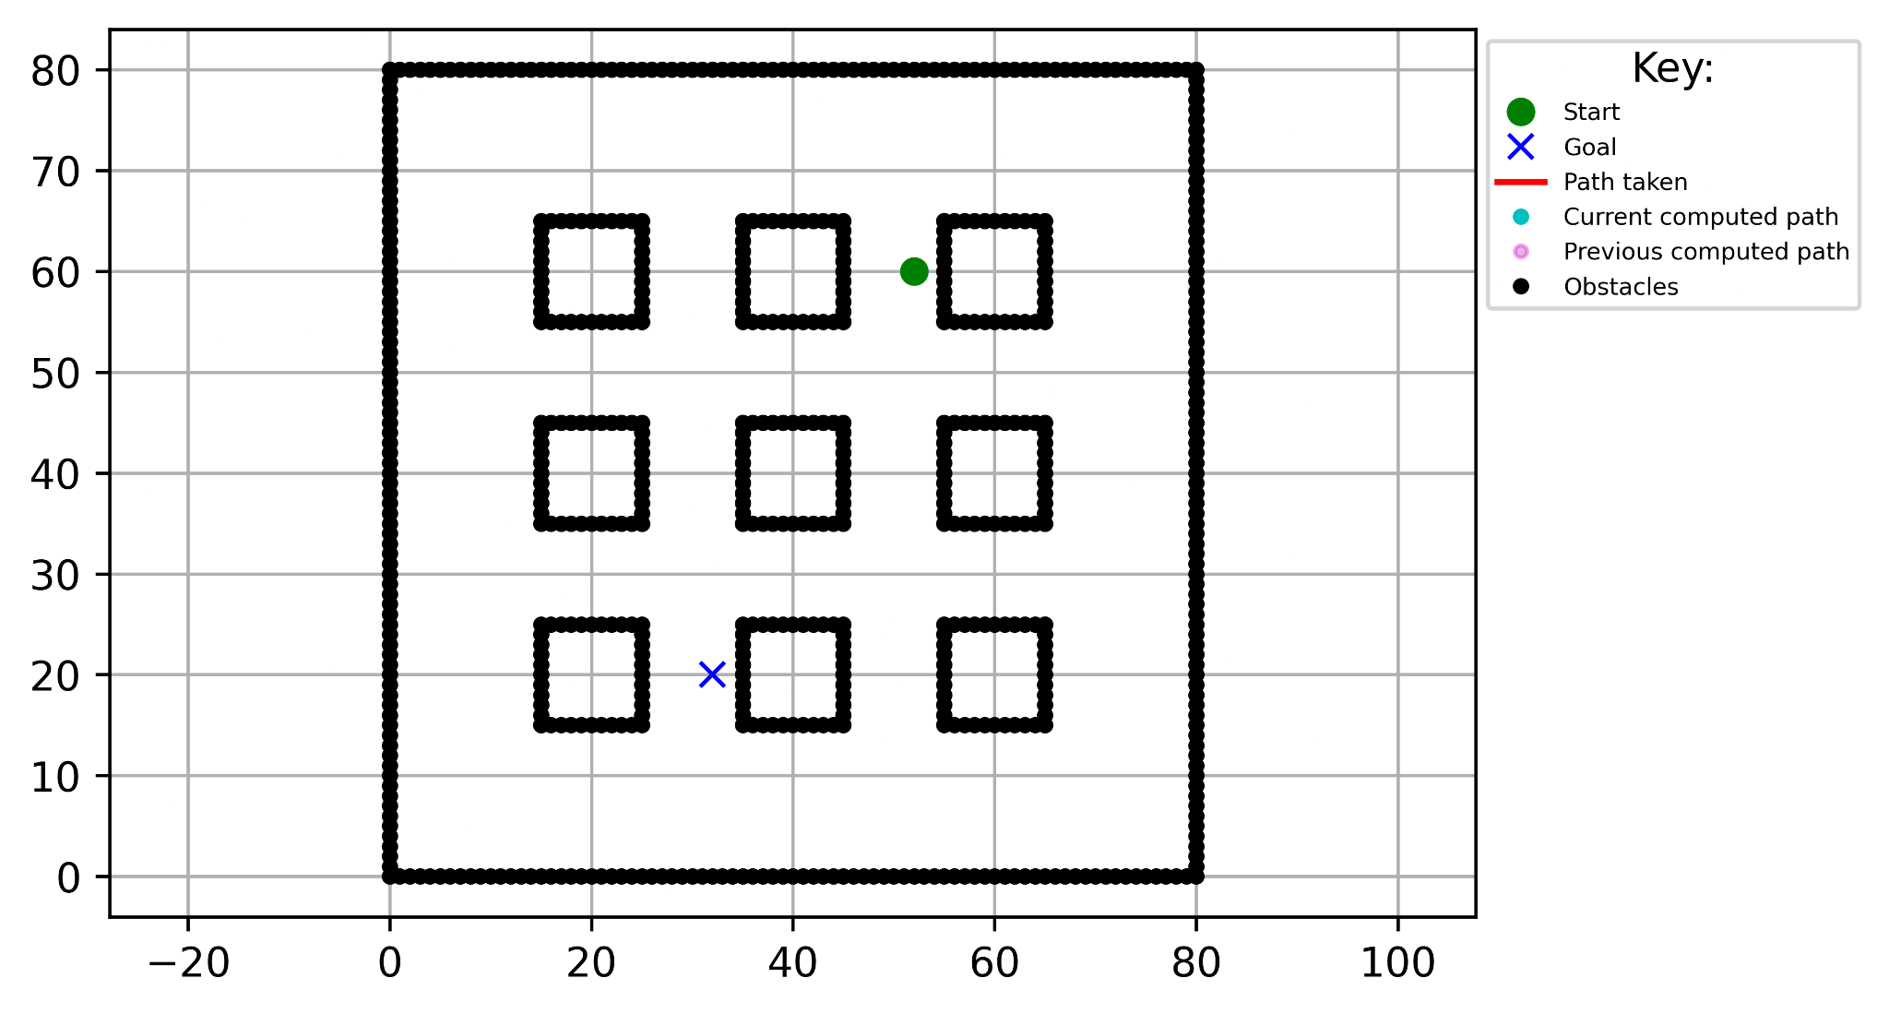
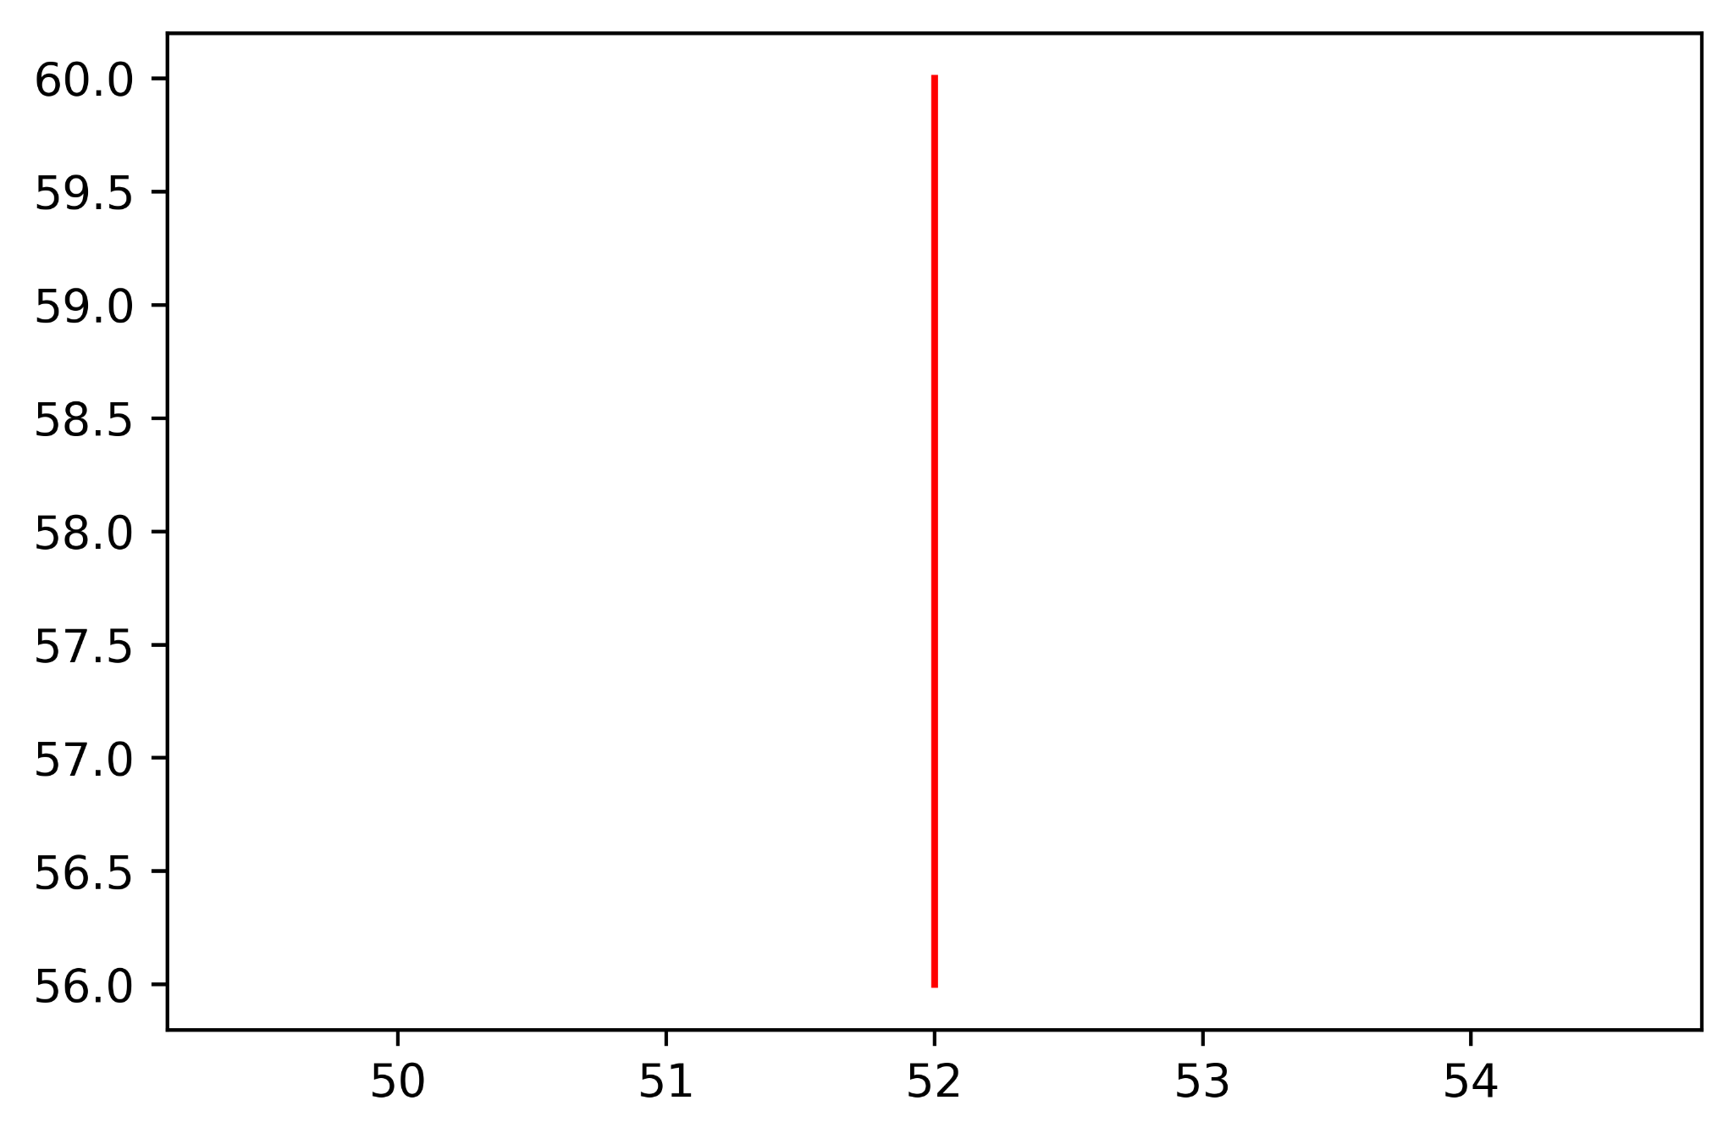
D* Lite: Results (Cont’d…)
Iteration 1:
The path is then computed.
In the next iteration, the previous goal node is now the start node.
The robot starts moving along the path.

Slide 18
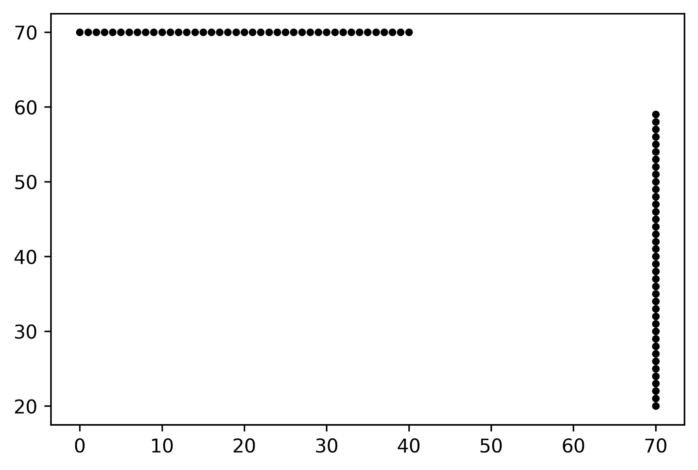
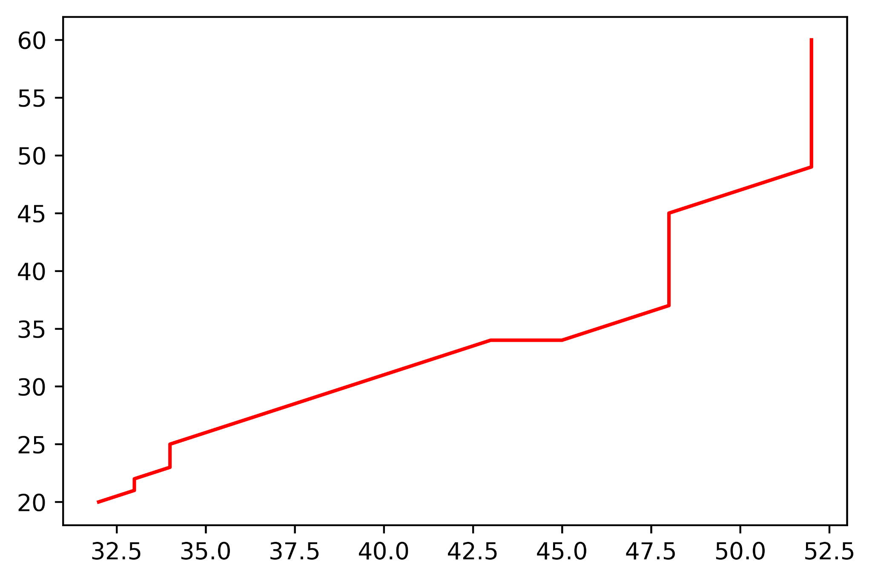
D* Lite: Results (Cont’d…)
Pre-defined obstacles are once again introduced into the environment using random().
However, here, the obstacles do not block the previously computed path and so, a new path is not computed.

Slide 19
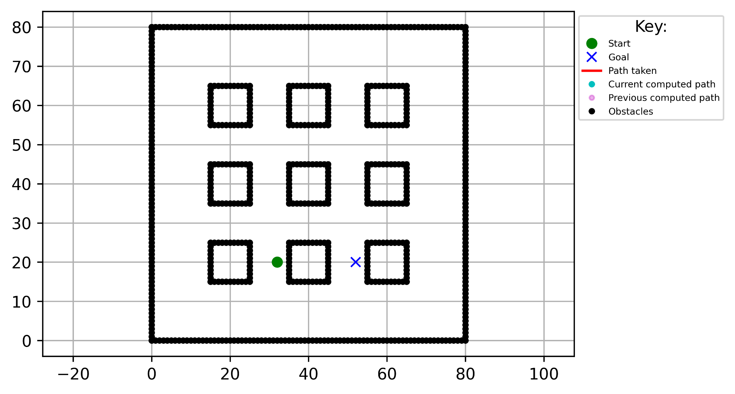
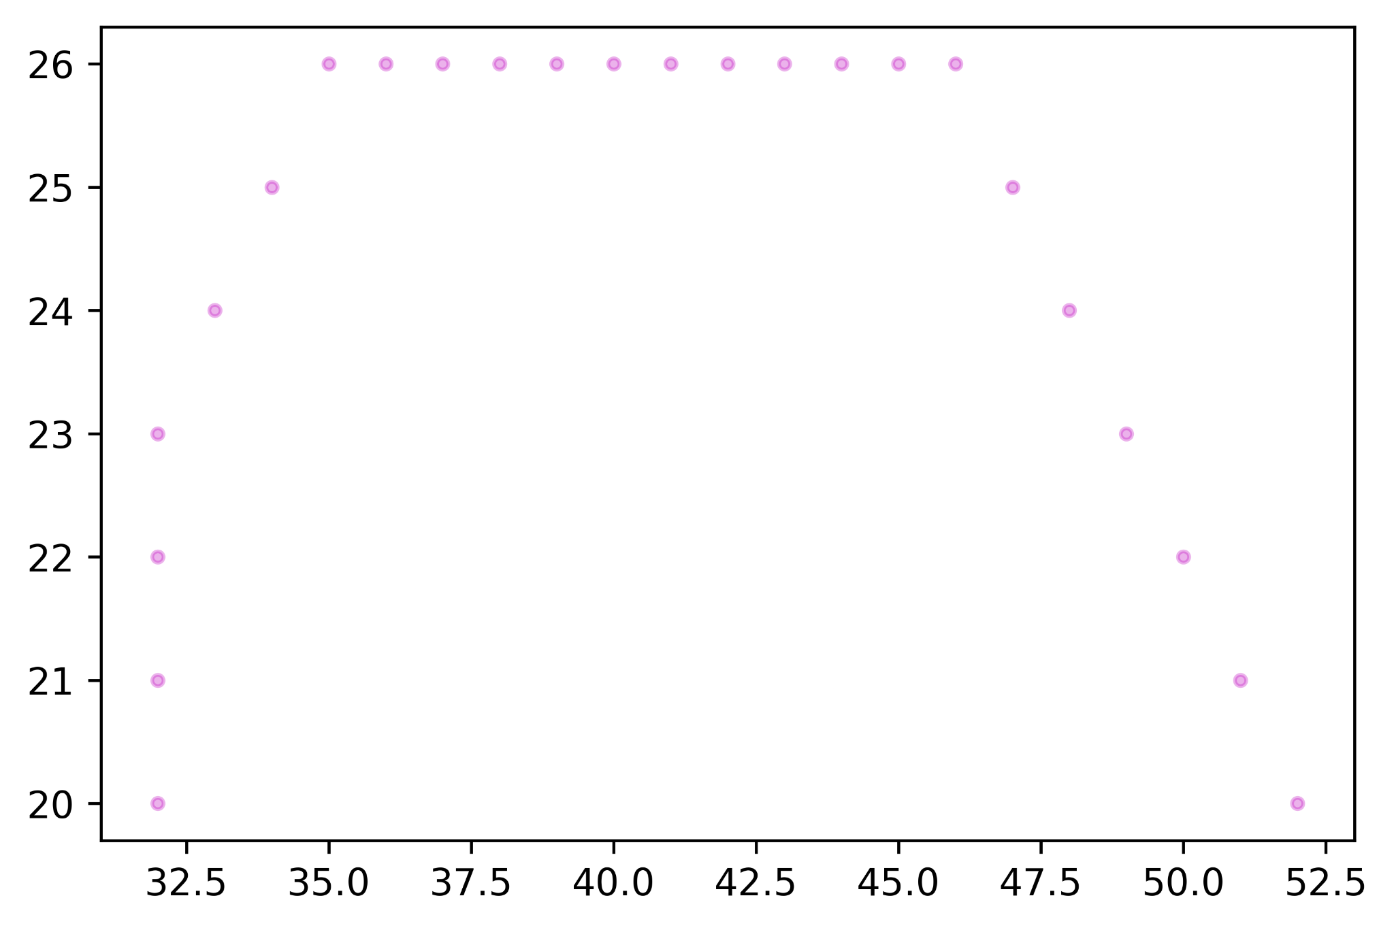
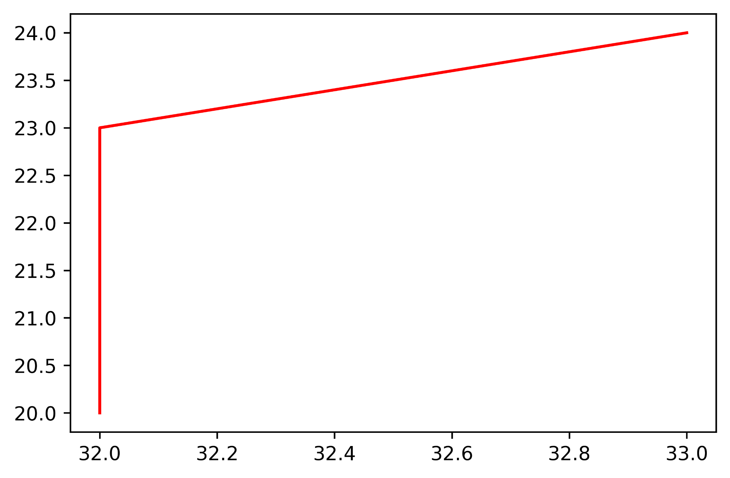
D* Lite: Results (Cont’d…)
Iteration 2:
The path is then computed.
The new start node is the previous goal node.
The robot starts moving along the path.

Slide 20
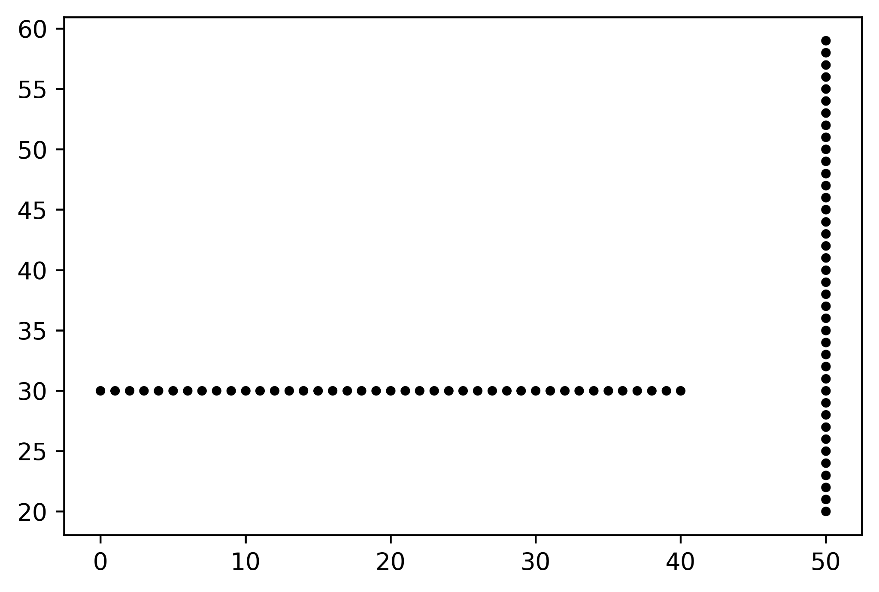
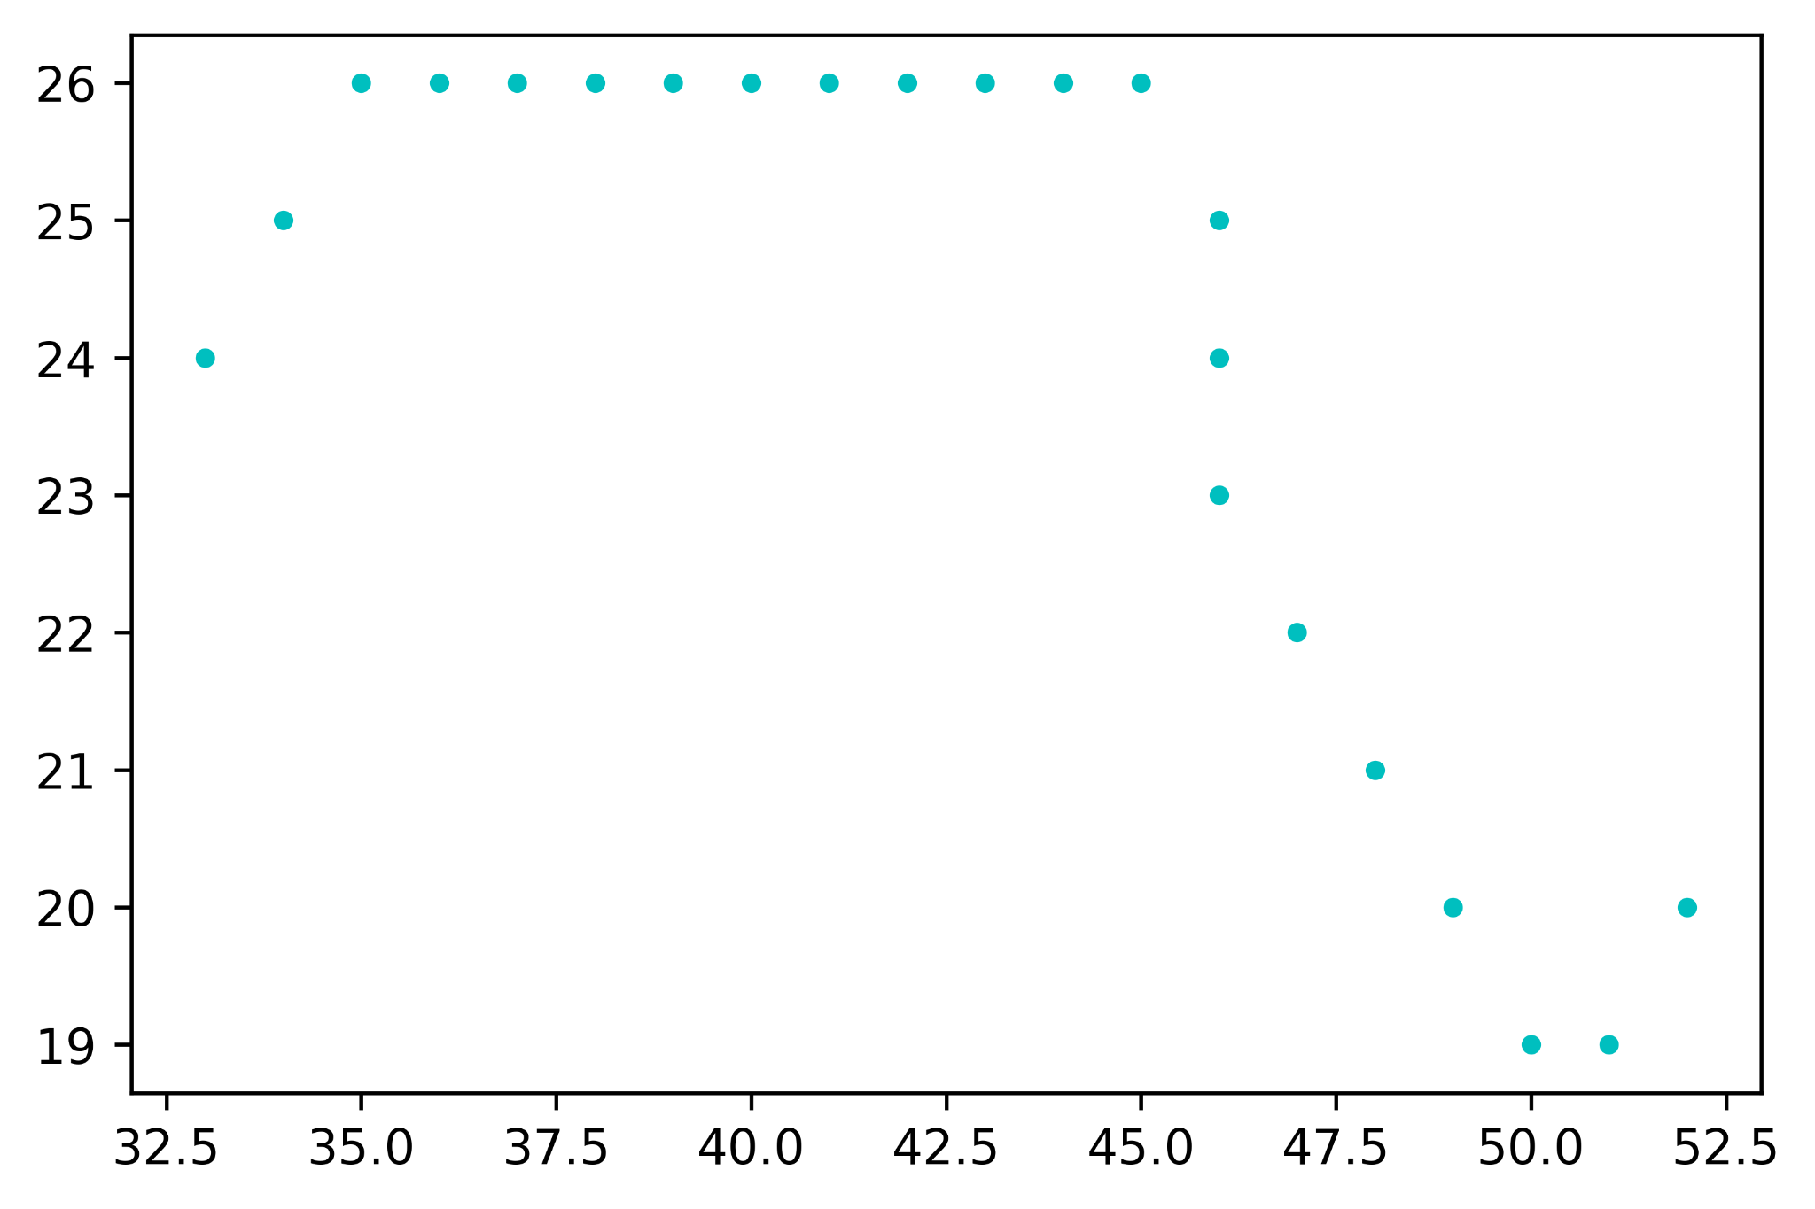
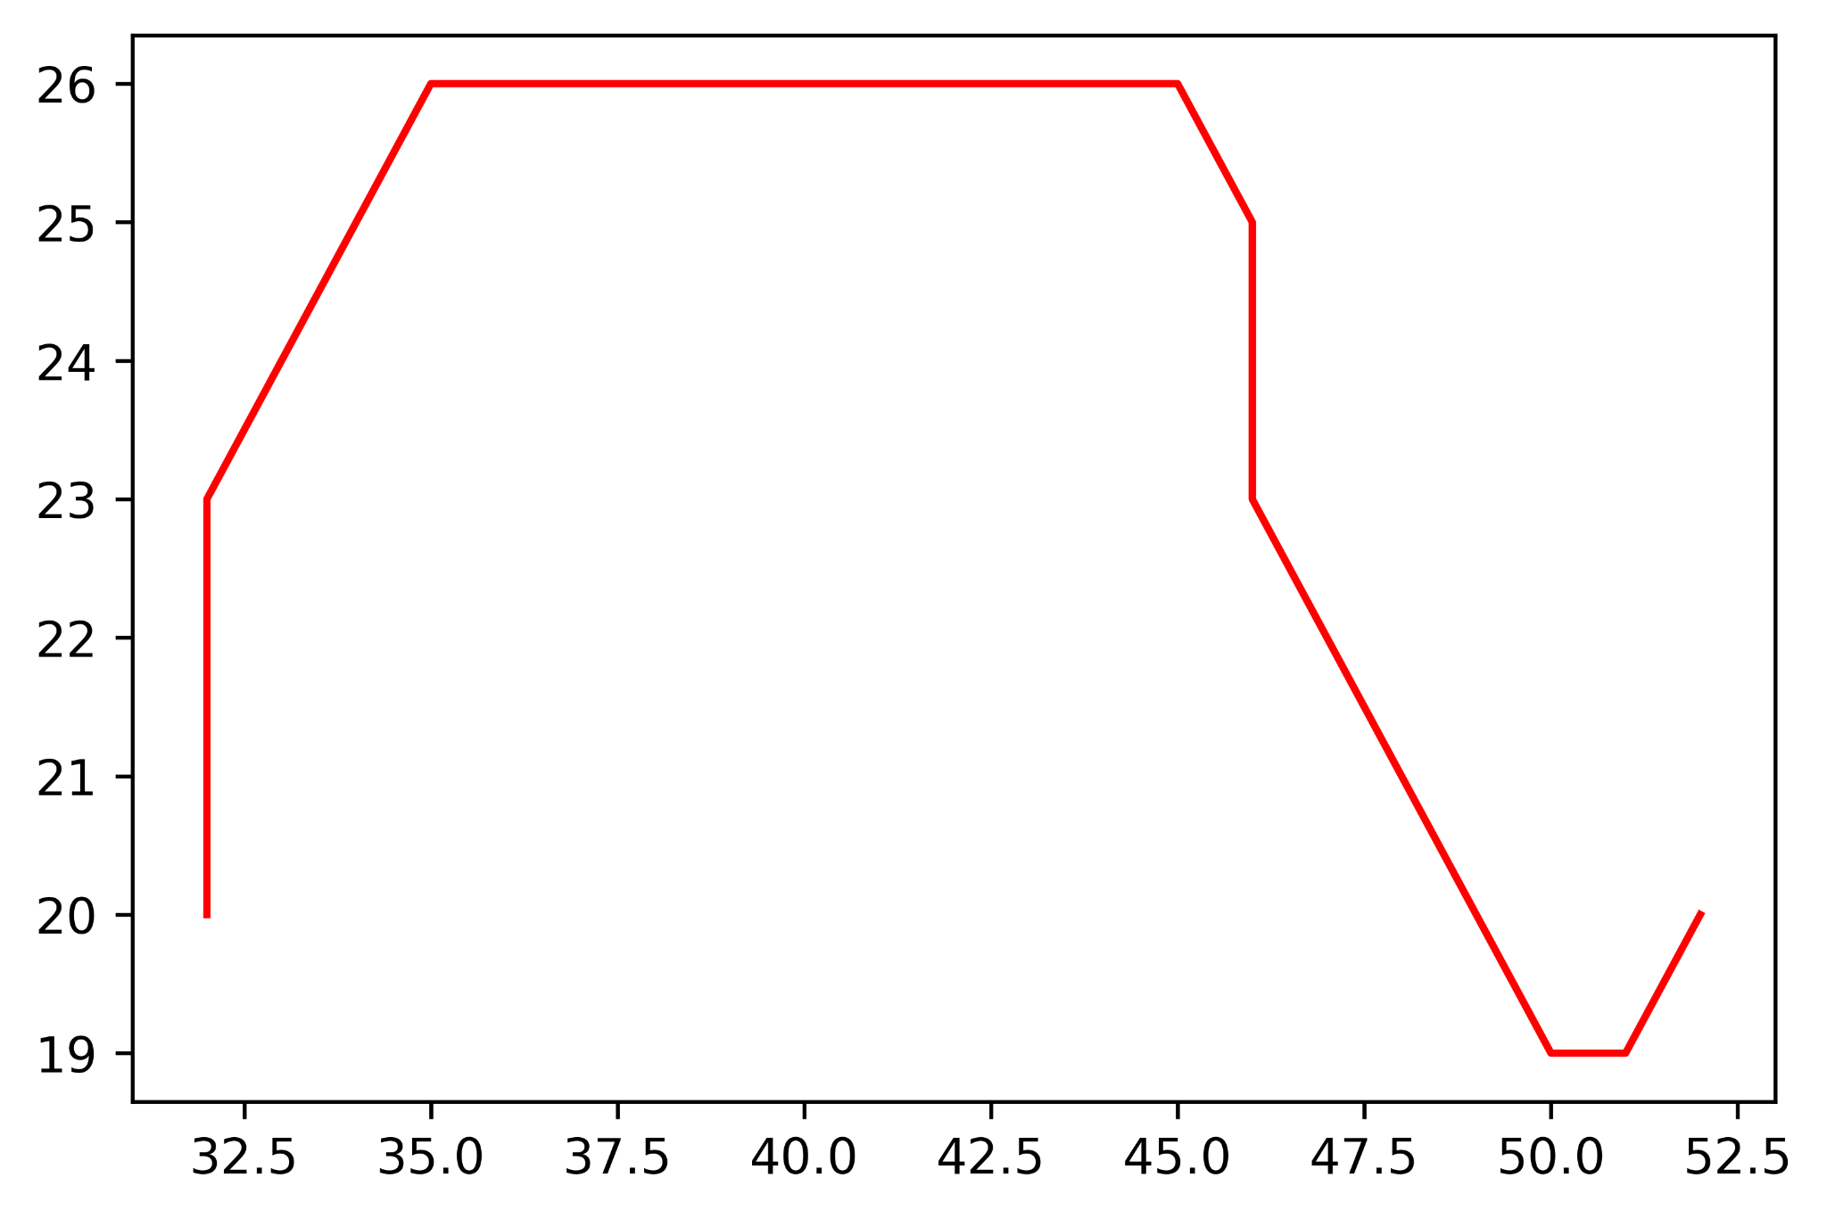
D* Lite: Results (Cont’d…)
The path is recomputed.
Obstacles are introduced.
The robot moves along the course corrected path.

Slide 21
box2d: Results
The robot starts at (10,10) and moves forward until it detects an obstacle.
The different states of the robots are by functions in a finite state machine.
It continuously measures the distance of the obstacle that is in front of it.
If the obstacle distance<8 units, the robot stops.

Slide 22
FastSLAM: Results
A restaurant-like environment has been created, with 9 tables, each of 8 points, which act as landmarks..
Here, the robot moves in an arc.
The estimated landmarks are found, and then the trajectories (both true and estimated) are plotted step by step.
The algorithm uses a particle filter for sampling robot paths, and extended Kalman filters for representing maps acquired by the vehicle.

Slide 23
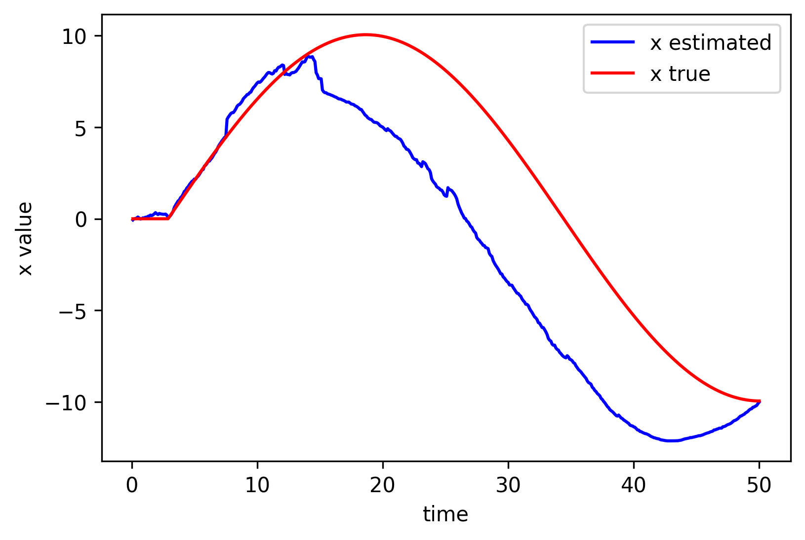
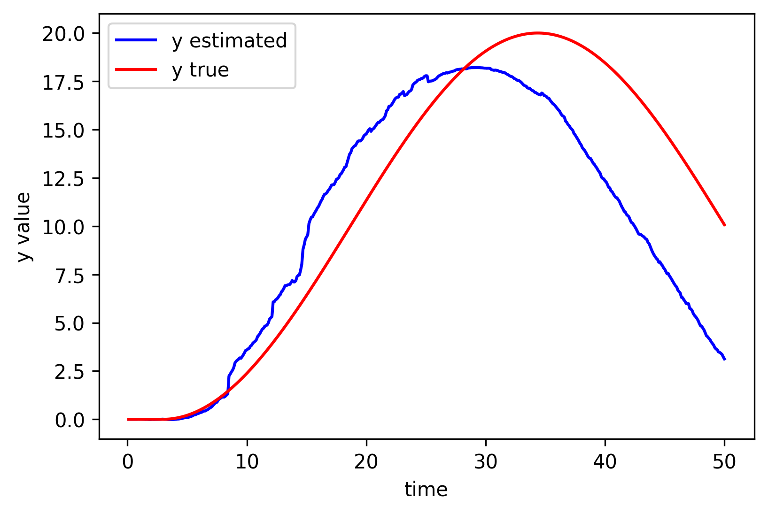
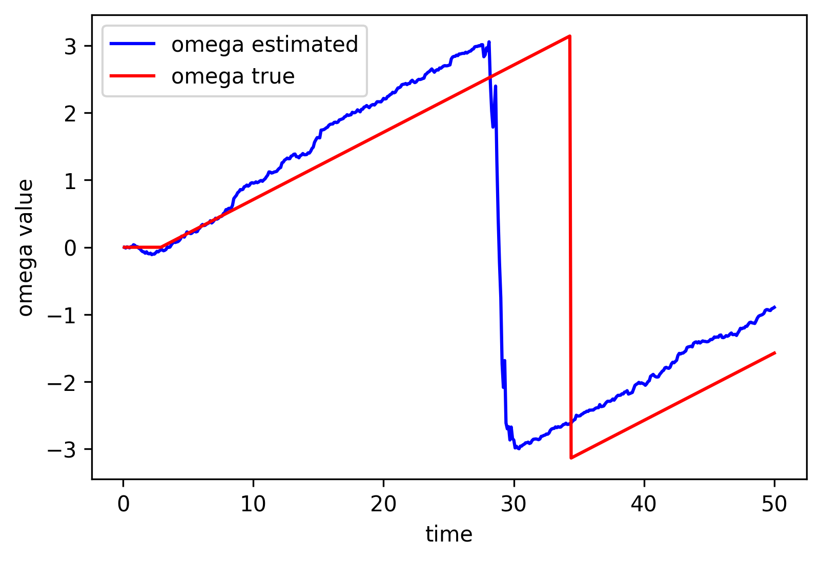
FastSLAM: Results (cont’d…)
We have then extracted the true range as well as estimated range values from the sensor measurements for x, y and omega (rate of change of angle). We have then plotted them against time in the same plot for estimated and true for comparison.

Slide 24
Conclusions
In this project, we have tackled various problems with respect to a catering robot. Improvements can be made to the approaches here and there is scope to extend it:
In the box2d simulation, working with the sensors proved to be complicated. Extracting and analysing these values can be useful.
For path planning, further uncertainty and dynamic obstacles can be implemented to get a more general model.
Exploring newer approaches to the SLAM problem can be done so as to get a much more comprehensive map and better understanding of localization.
Integrating these aspects to a Mobile Robot can be done and tested.

Slide 25
References
https://www.researchgate.net/publication/251945230_Catering_Service_Robot
https://www.sciencedirect.com/science/article/pii/S1877050918309967
https://www.pudurobotics.com/product/detail/bellabot
http://idm-lab.org/bib/abstracts/papers/aaai02b.pdf
https://github.com/AtsushiSakai/PythonRobotics
https://github.com/bblais/RobotSim373
http://robots.stanford.edu/papers/Thrun03g.pdf
https://arxiv.org/abs/1808.10703

Slide 26
The Team
Ankit Ashok
Ayush Kasara

